Slide 1
The Data Analysis and Visualization of the Most Recent Updated Videos on Bilibili
STAS401 Tableau Project Presentation
Boqing Zheng, Shuhe Wang, Xingyu Shen
Data Science
Duke Kunshan University
Feb 10, 2023

Slide 2

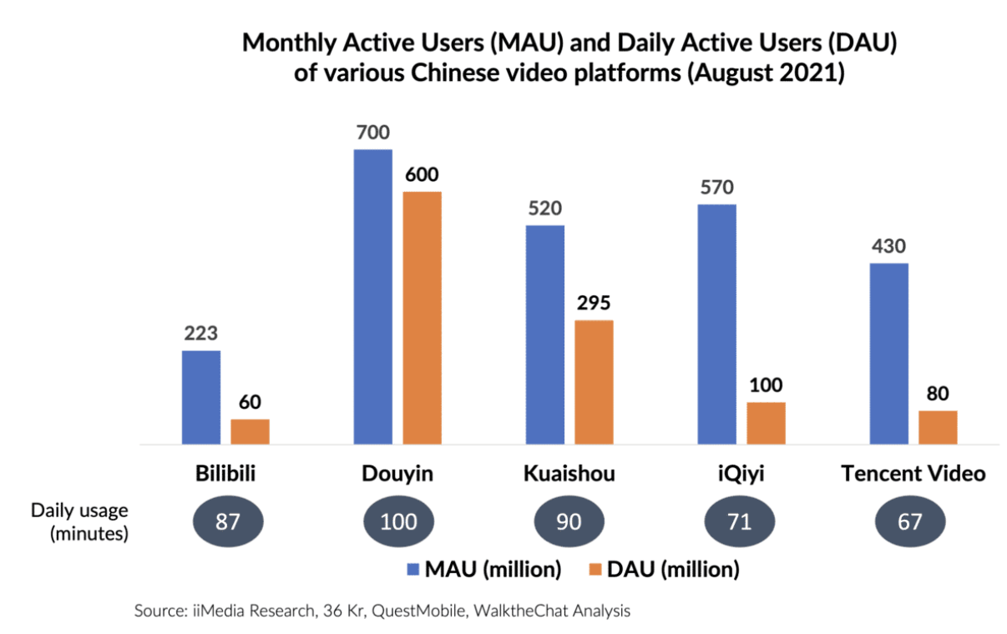
Introduction
Bilibili is an iconic brand and a leading video community for young generations in China.
“All the Videos You Like”
Golden opportunity from videolization
Unparalleled Leadership among Generation Z+
Highly sticky community with a strong sense of belonging

Slide 3
Introduction
Research Questions:
What is the relationship between feedbacks of the audience and the number of views?
What are the common characteristics of the videos published recently?
What are the popular topics and keywords of the videos among young people?

Slide 4
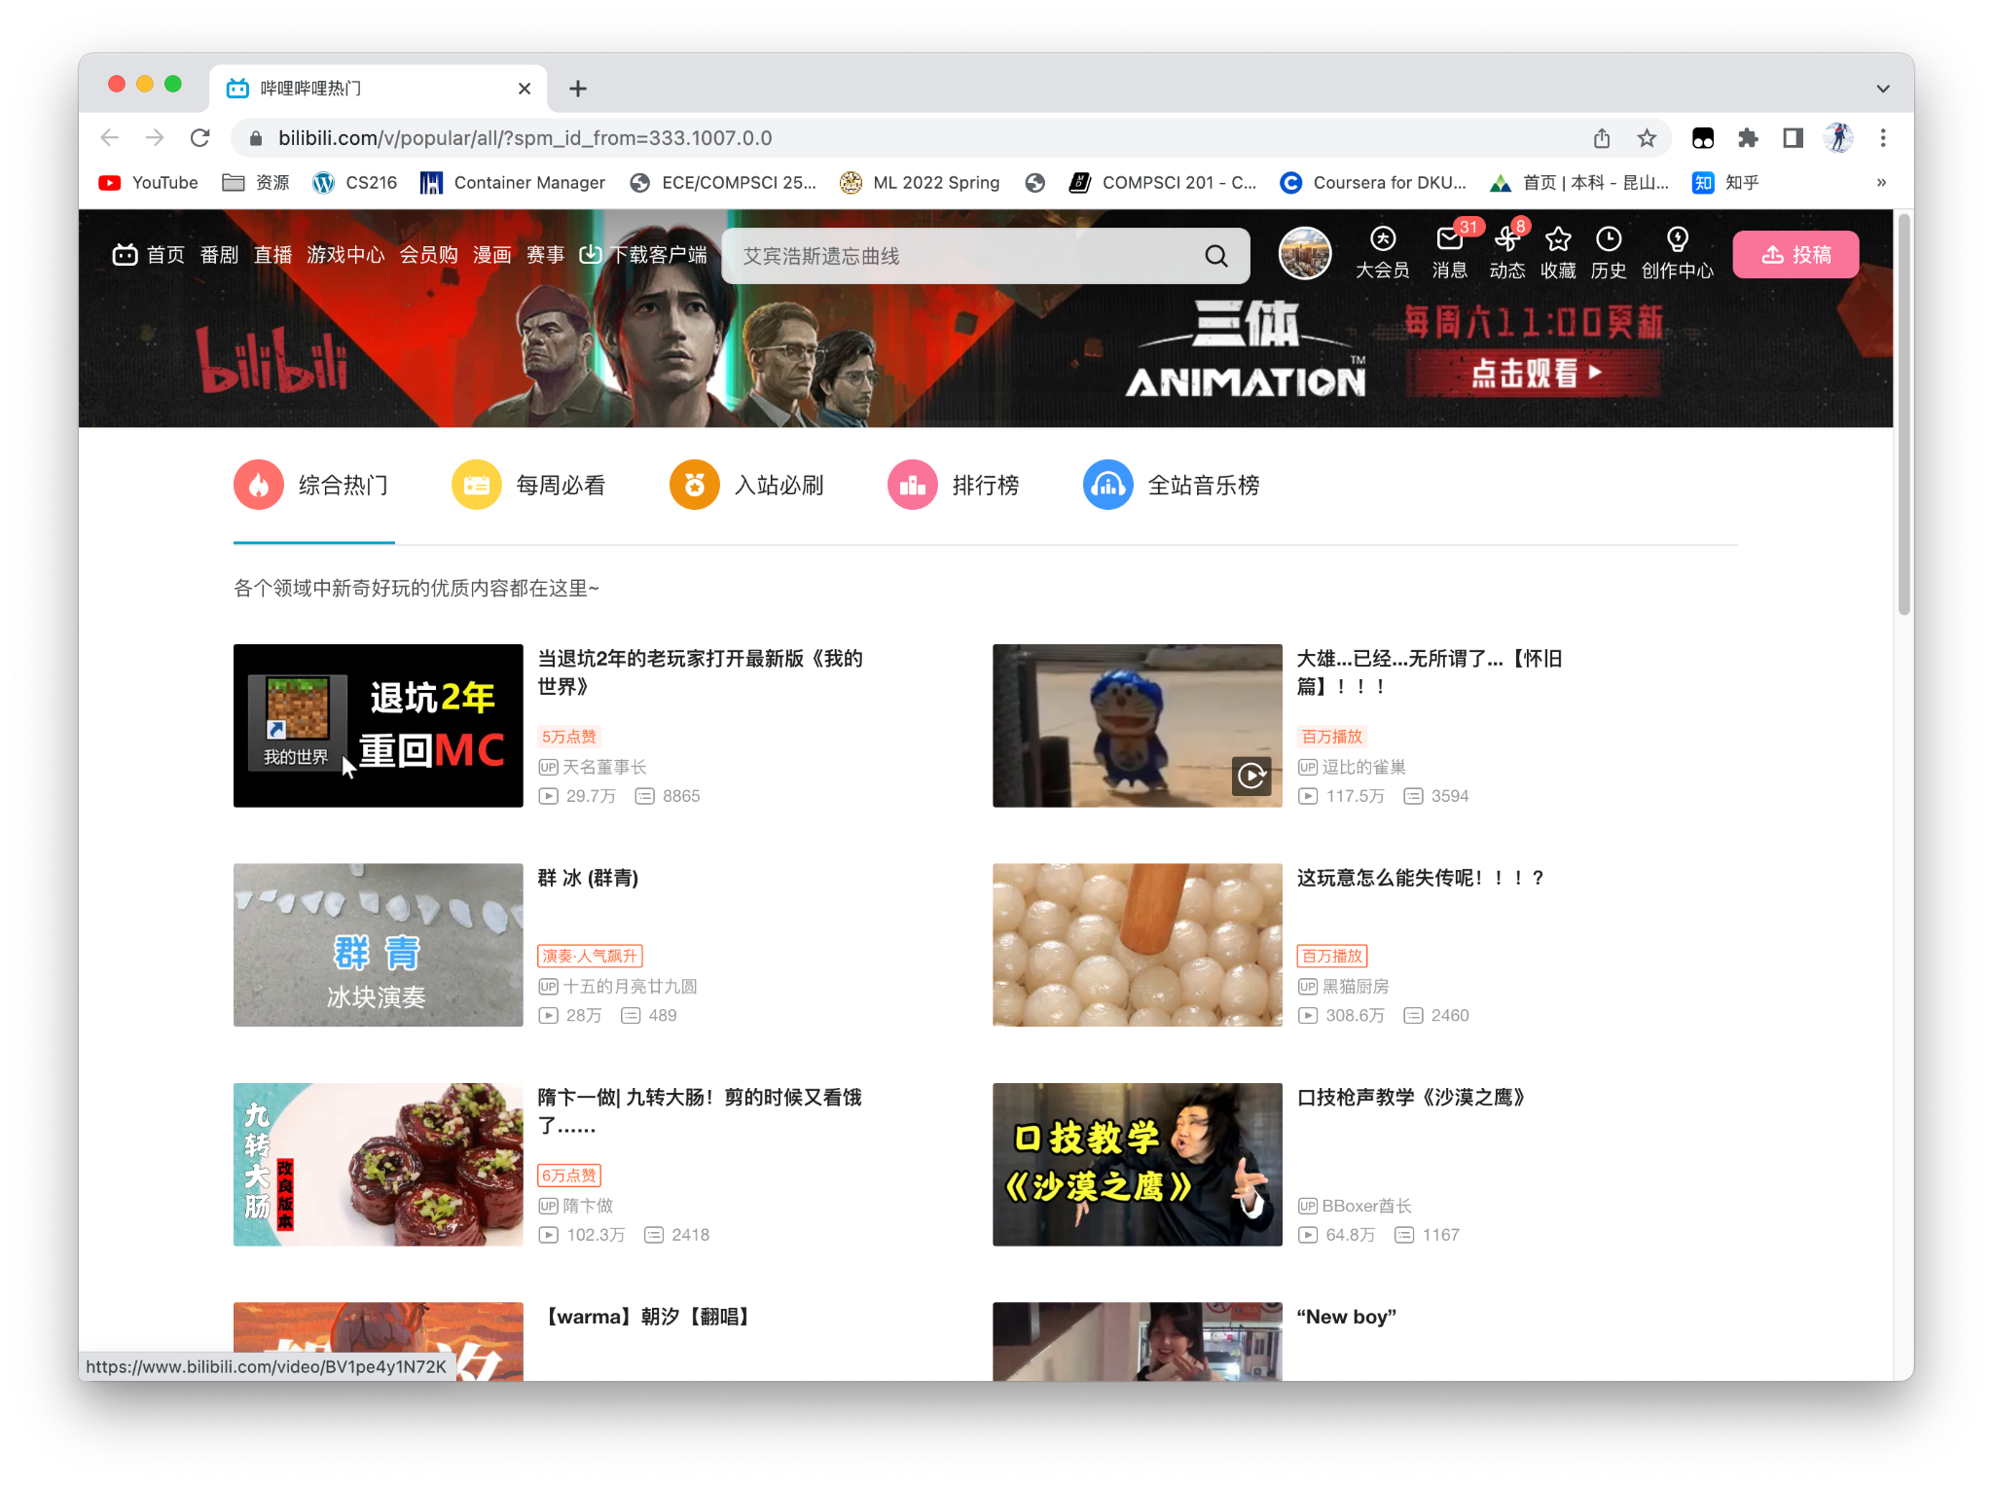
Methodology - Data Collection
Popular
(500 videos)
Weekly Popular
(6559 videos)

Slide 5
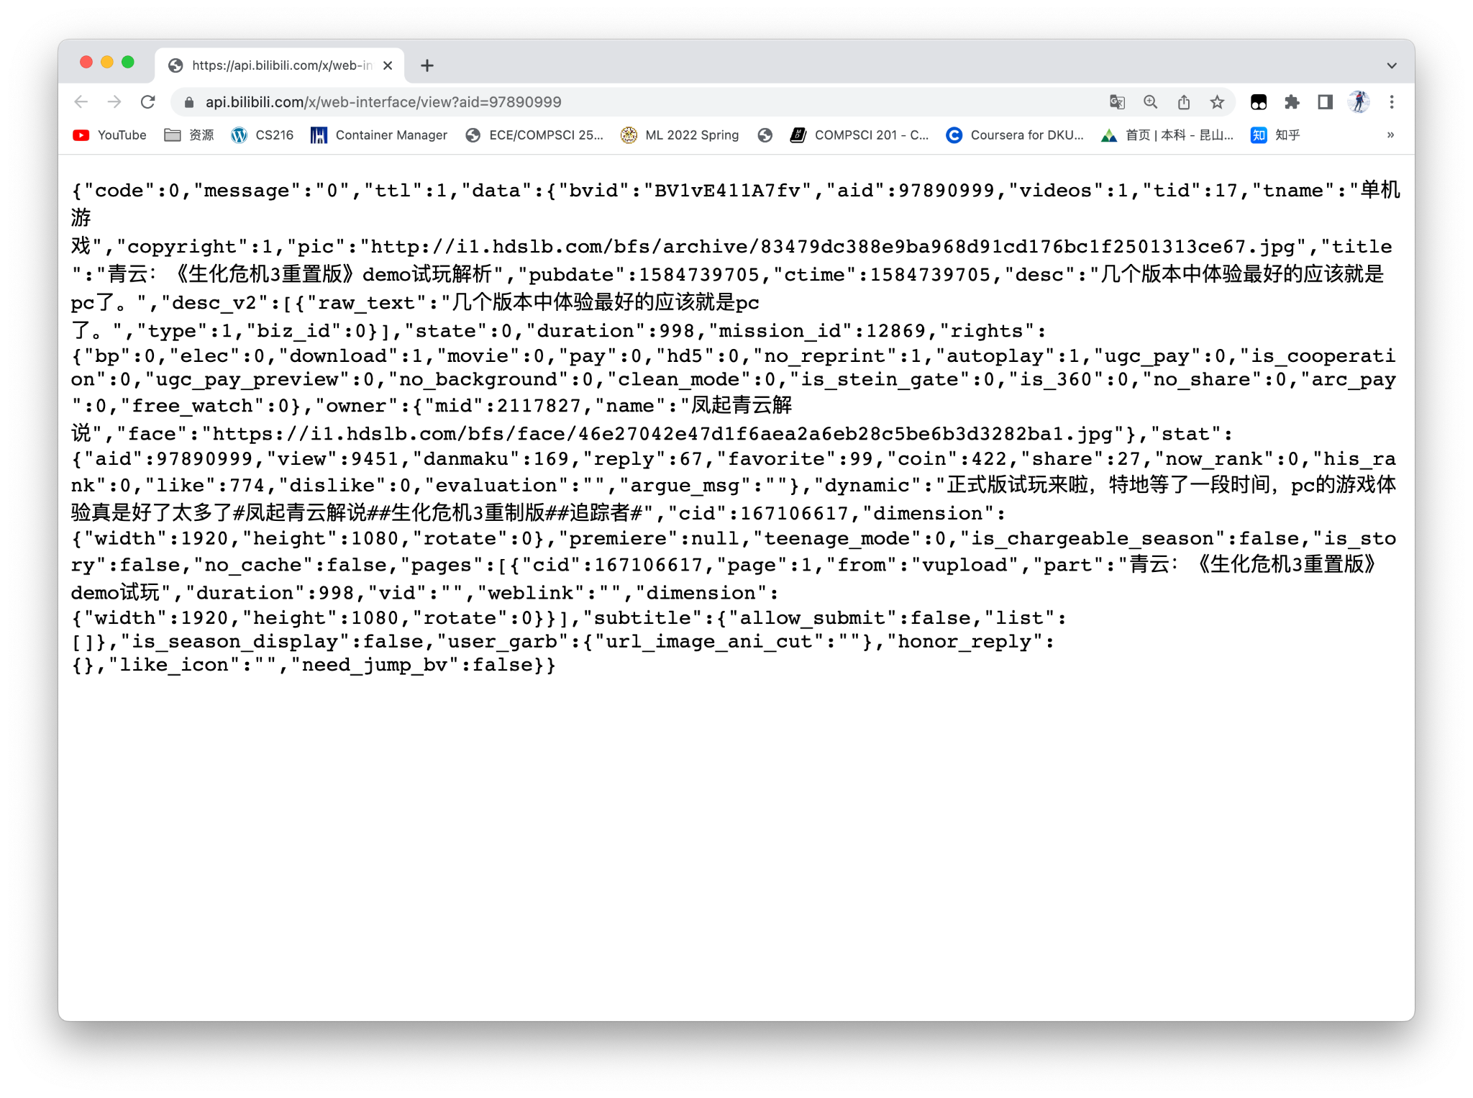
Methodology - Data Collection
Most Recent
(15000 videos)
Searching back from avid = 97890999
Column collected:
tid(type id), tname(type name), title, desc(description), duration, stat(interactive information of the video), dynamic, rcmd_reason, bvid(unique id of the video), owner, pub_location

Slide 6
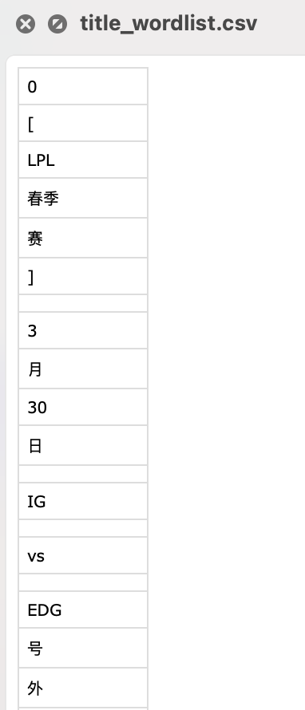
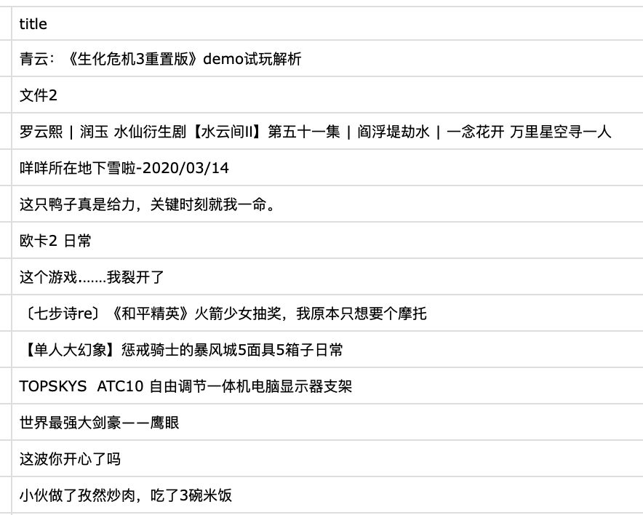
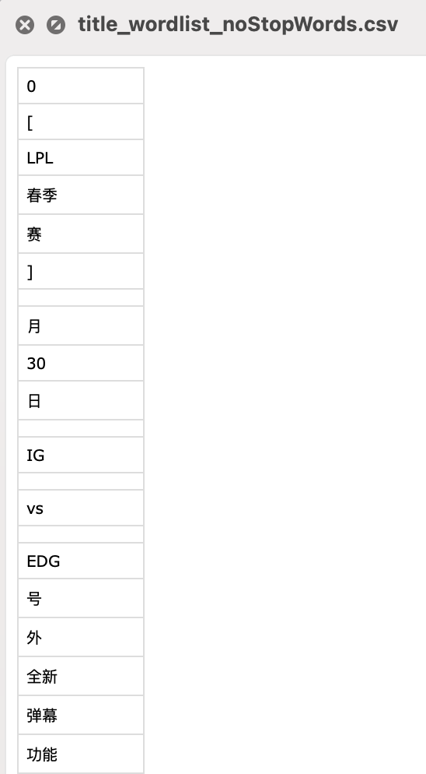
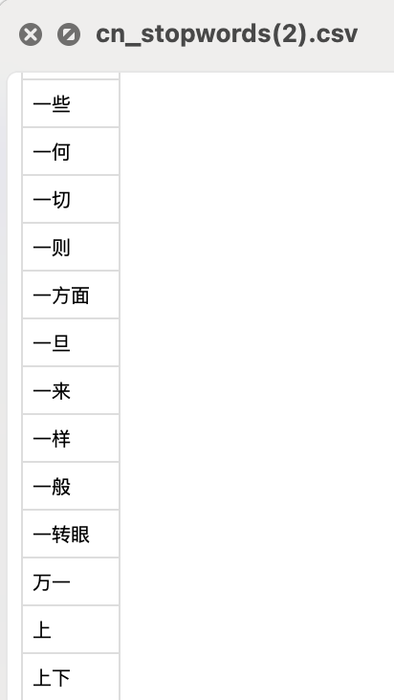
Methodology - Data Cleaning and Processing
Separating Chinese Words
Original Wordlist
Wordlist Without Stopwords
Column of text
Adapted Stopwords List

Slide 7
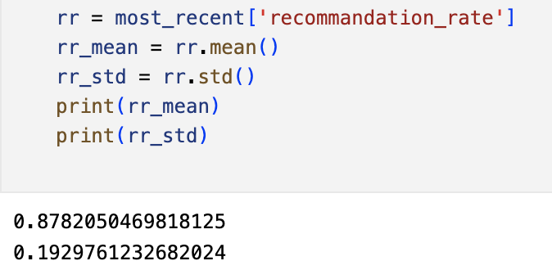
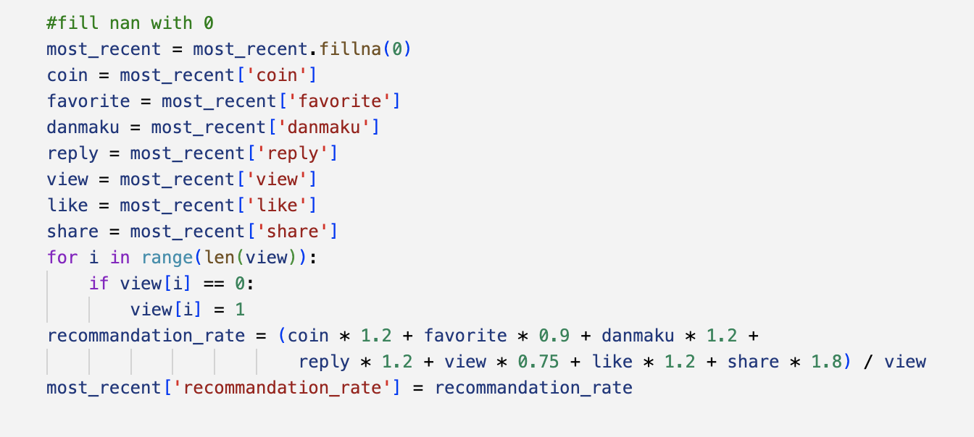
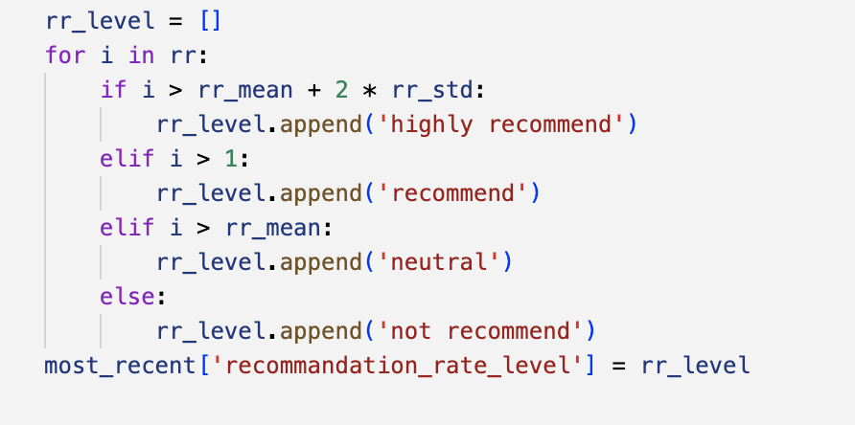
Methodology - Data Cleaning and Processing
Recommendation Level
Mean and Variance
Recommendation Rate
Recommendation Level

Slide 8
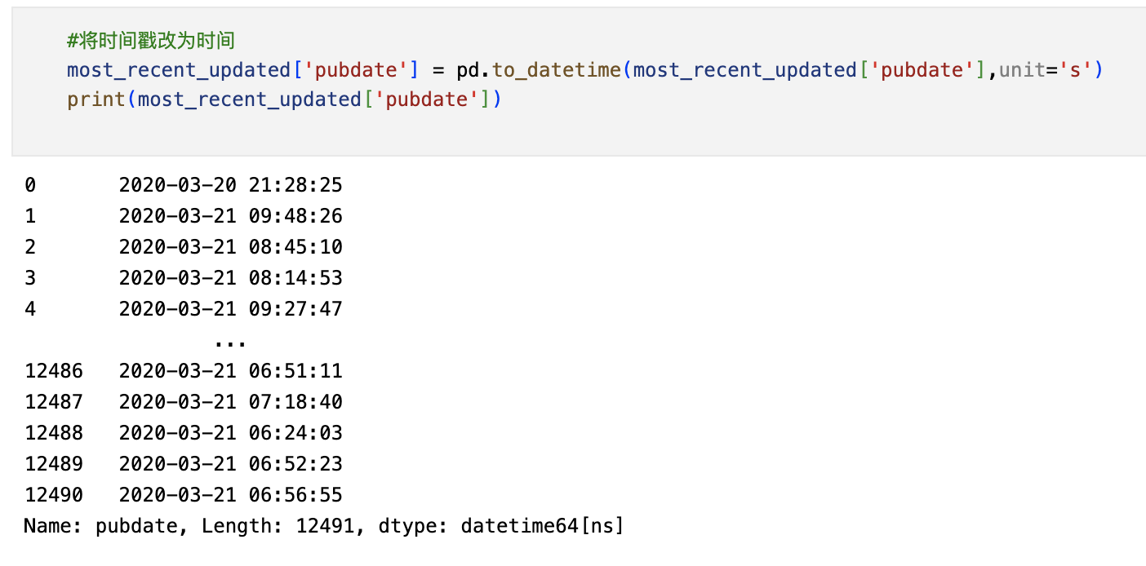
Methodology - Data Cleaning and Processing
Timestamps to Traditional Form

Slide 9
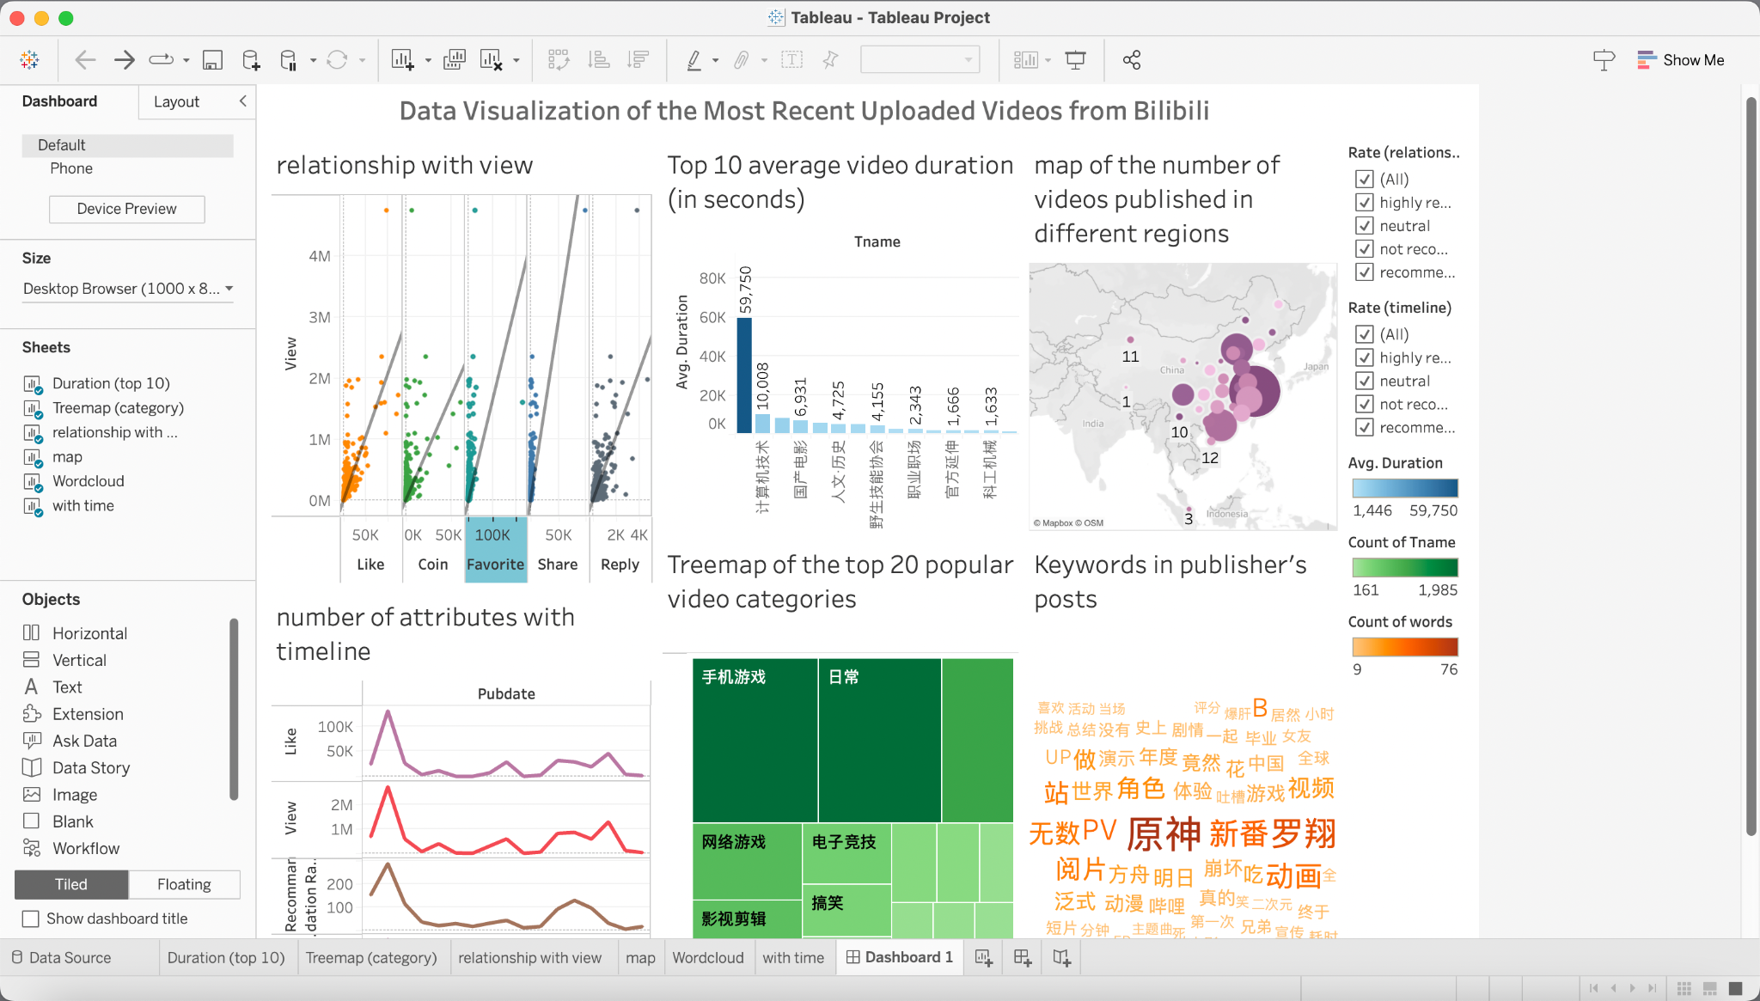
Methodology - Visualization
We visualized the data using Tableau with different attributes, idioms, marks, and channels.

Slide 10
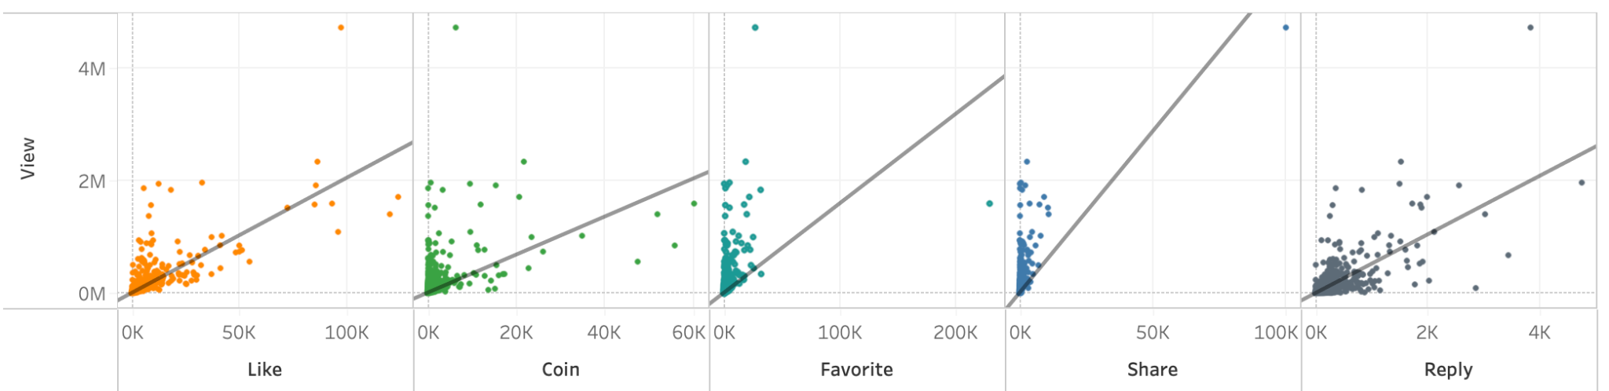
Results
The dot plots of relationship between the audience feedback and number of views:
User task: Find the relationship between elements of the audience feedback and the number of views.
What: This dot plot shows the relationship between the response of the audience towards the videos and the number of views.
Why: Seeing from the plot, users can figure out that the number of views is positively correlated to the number of the elements included in the response of the audience. The gradient of the trend line between share and view is obviously higher, which shows that the number of share can increase the number of views dramatically.
How: The audience can grasp the information by observing the distribution of the dots, finding the relationship between its abscissa and y-coordinate, and according to the trend line.

Slide 11
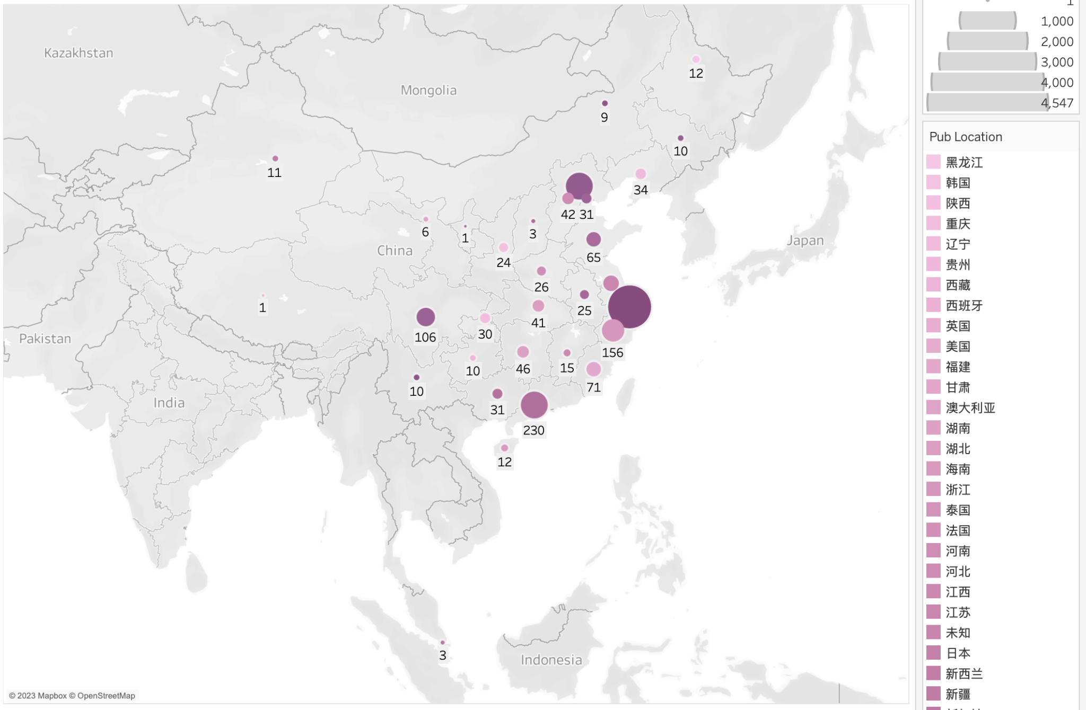
Results
(2) The symbol map of the number of videos published in different regions:
User task: Observe the amount of videos published on Bilibili in different regions.
What: This is a map with symbols of the number of videos published in different regions.
Why: Users will see that Beijing, Shanghai, and Guangdong are the three regions that have the most publications. It shows a trend that the regions with high developing speed and advanced technology may have more publications on Bilibili.
How: Users can see the amount of videos published in each region by the area and color saturation of each dot.

Slide 12
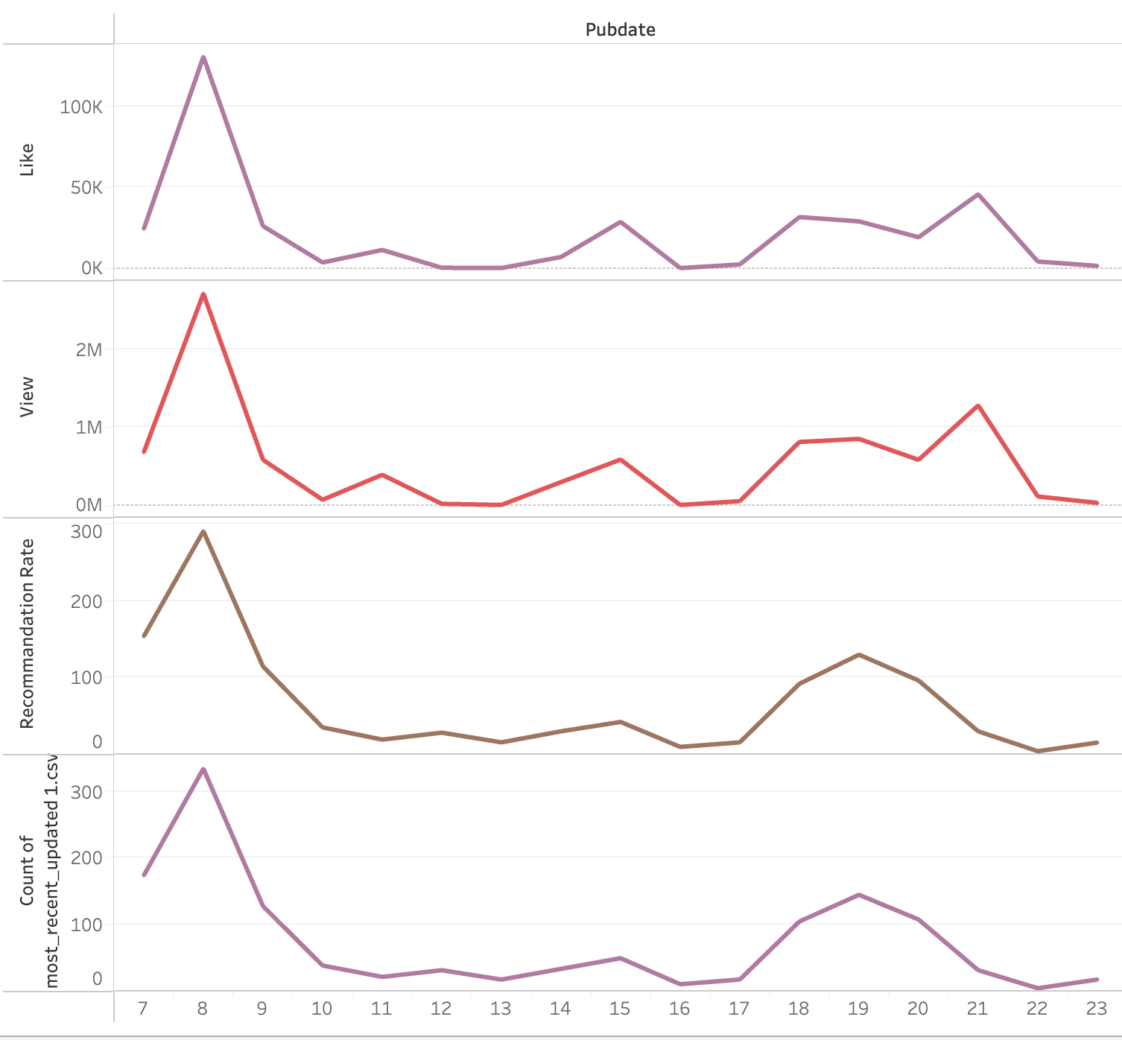
Results
(3) The line chart of the characteristics of the videos published in different hours
User task: Observe the amount of videos published on Bilibili in different regions.
What: This is a map with symbols of the number of videos published in different regions.
Why: Users will see that Beijing, Shanghai, and Guangdong are the three regions that have the most publications. It shows a trend that the regions with high developing speed and advanced technology may have more publications on Bilibili.
How: Users can see the amount of videos published in each region by the area and color saturation of each dot.

Slide 13
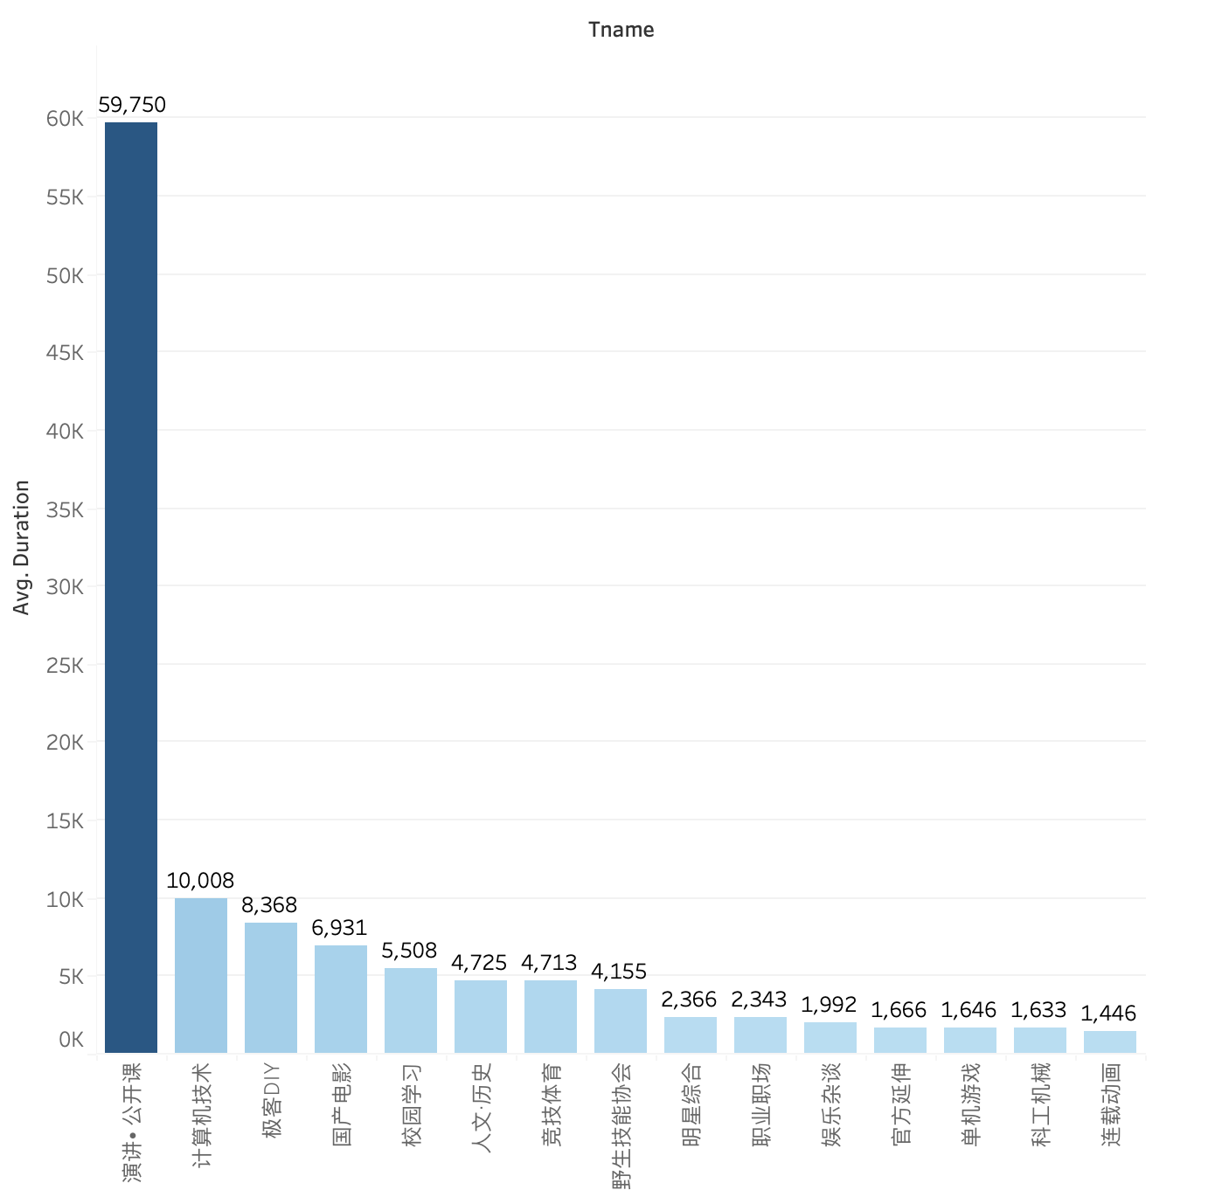
Results
(4) The bar plot of average duration of the videos from different categories:
User task: Retrieving value, characterizing distribution.
What: top 10 average video duration and video categories.
Why: Discover the distribution and rank of the average video duration of different categories.
Long: educational videos
Short: entertainment videos
How:
X-axis: categories
Y-axis: the average video duration
The height and color intensity reflect the magnitude of duration.

Slide 14
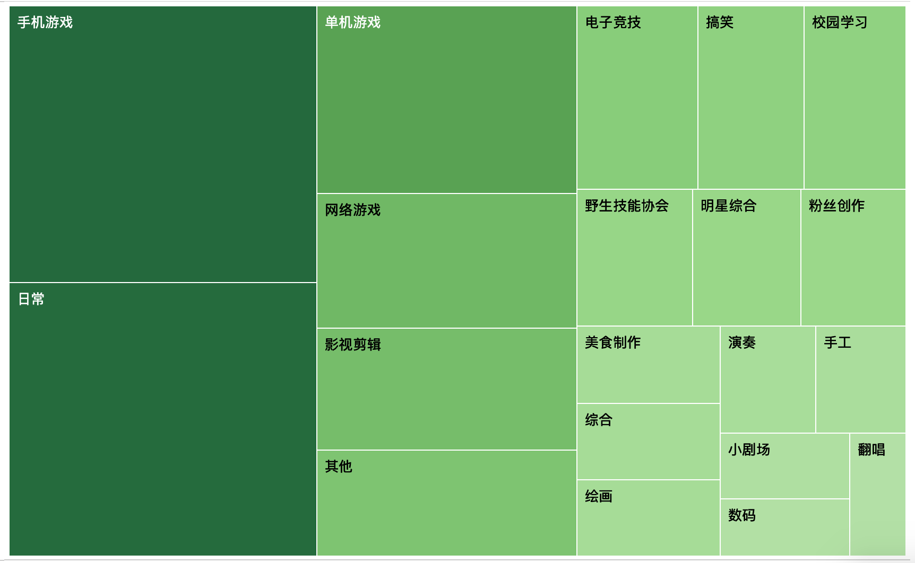
Results
(5) The treemap of the top 20 popular video categories:
User task: rank
What: The total number of videos posted on each category.
Why: Gauge video popularity.
Game videos and daily record videos are more published.
How:
Text indicates category
Size and color reflect the magnitude of number of videos.

Slide 15

Results
(6) The word cloud of the most frequently used keywords in the publisher’s posts:
User task: Sort and find extremum.
What: The keywords and the number of times in the video promotion.
Why:
Top 3: “动画/新番” (animation), “原神” (a mobile game) and “罗翔” (a famous law professor)
Frequent words: Publishers like to use exaggerated words such as “无数” (countless) to promote.
How: The darker the color, the larger the font, the more times the word appears.

Slide 16
Discussion
Advantages
Limitations
Our visualizations perfectly show the data we collected and answer our research questions.
Our data is not distributed across different days.
Jieba package is not strong enough to separate some of the commonly used words by bilibili users.

Slide 17
References
“Corporate Information.” n.d. Accessed February 5, 2023. https://ir.bilibili.com/en/corporate-information/.
Song, Shilin. n.d. “What Is Bilibili? A Look into One of China’s Largest Online Video Platforms - WalktheChat.” Accessed February 5, 2023. https://walkthechat.com/what-is-bilibili-a-look-into-one-of-chinas-largest-online-video-platforms/.
“大揭秘！B站‘热门’视频是怎么选出来的？.” n.d. 知乎专栏. Accessed February 5, 2023. https://zhuanlan.zhihu.com/p/490919116.

Slide 18
Thanks!
Q&A

